Slide 1

CS4000 Intelligent Systems
Solving Problems with Informed Search
Santiago Conant, Ph.D. sconant@itesm.mx

Slide 2

Contents
Informed search concepts
Heuristic search algorithms
greedy search
A* search
Variants of the A* algorithm
Heuristic design
Other uses of heuristics
Conclusions

Slide 3


Heuristic or informed search
Use some method to control or guide the search for a solution (heuristics).
Educated assumptions.
Intuitive criteria.
Common sense.
What are heuristics used for?
To order a search.
Search first on the most likely nodes.
To control the search width.
Try the deepest at the expense of the width.
Types of heuristics
Goal-oriented.
Knowing what you are trying to find.
Based on knowledge.
Using specific domain knowledge to depurate your search.

Slide 4

Heuristics
Informed vs uninformed search
DFS, BFS, iterated deepening are inefficient
You want to make a more intelligent search exploiting domain knowledge and constraints of the problem.
General mechanism: Evaluation function (f)
Choose from the queue nodes, always expanding the "best" in each iteration.
Estimate "quality" of each node, by means of the estimated cost of the cheapest route to a target state (h).
It does not have to be exact, any clue is good.

Slide 5
Examples of heuristics
Route between cities
Straight distance to destination city.
Traveling salesman
Path length.
8-puzzle
Number of pieces out of place.
N-queens
Total attacks between queens.
Chess
Material value (Queen=3, pawn=1).

Slide 6
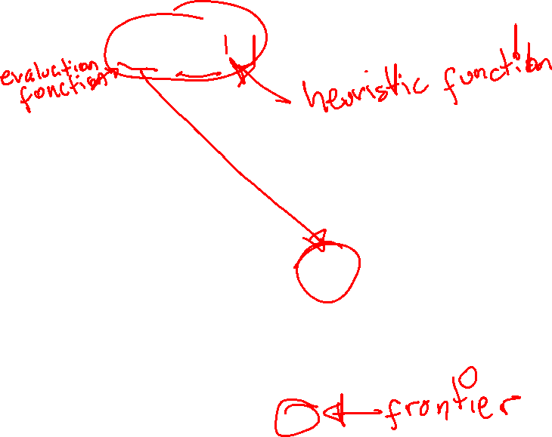
Greedy search
“Best-first“ search where f (n) = h (n)
Algorithm:
Initialize the cost of the initial node to 0
Place the initial node in the list
If the initial state is the goal
You finished
If the list is empty
There is no solution
If not
Select the node of the list with the minimum FEV
If the selected node is the goal
You finished
If not
Expands the selected node
Calculates FEV for each successor = heuristic estimation
Insert each successor if not already in the list
Repeat

Slide 7










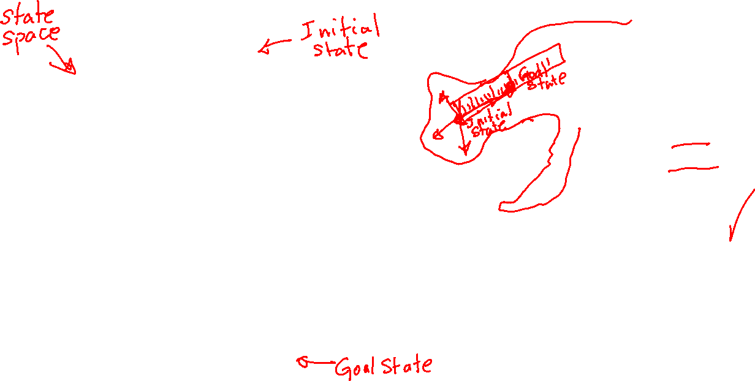
Example: Tour of Europe
heuristics = Straight distance to the goal.
300
320
350
340
250
510
125
630
430
680
485

Slide 8
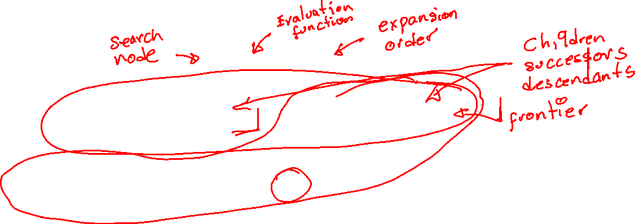
Greedy search
Paris (F = 1400)
(1)
Bordeaux (F = 1100)
(2)
Strasbourg (F = 1120)
Saint Sebastian (F = 900)
Lyon (F = 780)
(3)
Paris
Bordeaux
Strasbourg
Saint Sebastian
Lyon
Geneva
Grenoble (F = 680)
(4)
Strasbourg (F = 1120)
Barcelona
Grenoble
Cannes
Cannes (F = 0)
(5)

Slide 9
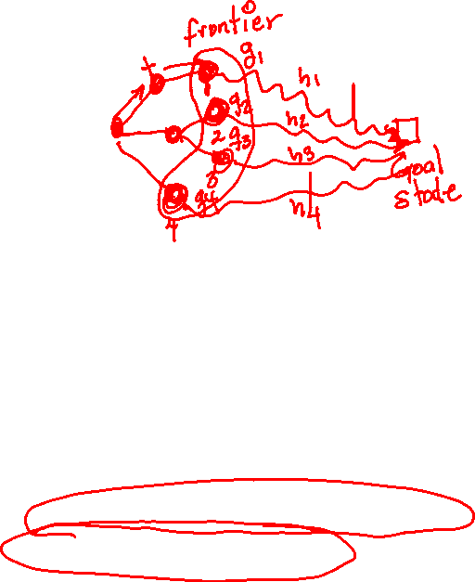
A* search
“Best-first" search where f (n) = g (n) + h (n)
Algorithm:
Initialize the cost of the initial node to 0
Place the initial node in the list
If the initial state is the goal
You finished
If the list is empty
there is no solution
If not
Select the node from the list with minimum FEV
If the selected node is the goal
You finished
If not
Expands the selected node
calculates FEV for each successor = cumulative cost + heuristic estimation
Insert each successor in the list by removing redundant nodes
Repeat

Slide 10

A* search
Paris (F = 0 + 1400)
(1)
Bordeaux
(F = 300 + 1100)
(2)
Strasbourg
(F = 320 + 1120)
(4)
Saint Sebastian
(F = 550 + 900)
Lyon
(F = 650 + 780)
Lyon
(F = 660 + 780)
Geneva
(F = 830 + 630)
(5)
(3)
Paris
Barcelona
(F = 980 + 480)
Grenoble
(F = 775 + 680)
Bordeaux
Strasbourg
(6)
Strasbourg
(F = 990 + 1120)
Saint Sebastian
Lyon
Geneva
Barcelona
Grenoble
Cannes
(F = 1455 + 0)
Cannes
(7)

Slide 11
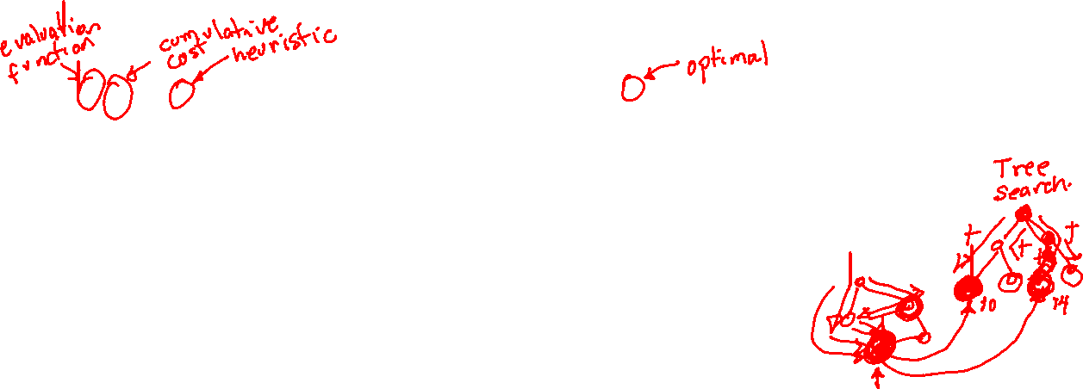
A* search
f, g, and h are estimates of the true valueS f*, g*, and h*.
It requires knowledge of the cost of each movement as in the uniform cost search, to calculate g.
If the search is on tree, g = g*, where there is only one way from the initial node to the current node.
In general, the search can be a graph. In this case, g >= g*, therefore, it can not be less than the cost of the optimal path. This can only exceed the cost.
g can be = g* in a graph, if nodes are chosen appropriately.
A* search will be optimal in a tree if for each node:
h(n) >= 0,
h(n) <= h*(n), i.e., it never overestimate the distance to the closest goal state (ADMISSIBILITY CONDITION).

Slide 12
More comments about h
If h = h* (perfect heuristic estimation), unnecessary nodes are never expanded.
If h = 0 then A* searches blindly as the uniform cost algorithm.
Goal: Let h get as close as possible to h* without exceeding it.
If h* >= h1(n) > h2(n), h1 is more "informed" that h2.
The admissibility condition can be relaxed for efficiency purposes, but then the solution found may not be optimal.

Slide 13
More comments on h
A* search will optimal in a graph if in addition to the conditions of the tree search, the heuristic estimation is consistent (monotonic).
A heuristic estimation is consistent if h(n) <= c(n, a, n') + h(n') for each node n and every action a generating successors n' from n with a cost of c.
This ensures important things for optimality:
The values ​​of f(n) through any branch are not decreasing.
Each node is explored from its optimal branch
The heuristic is admissible.

Slide 14
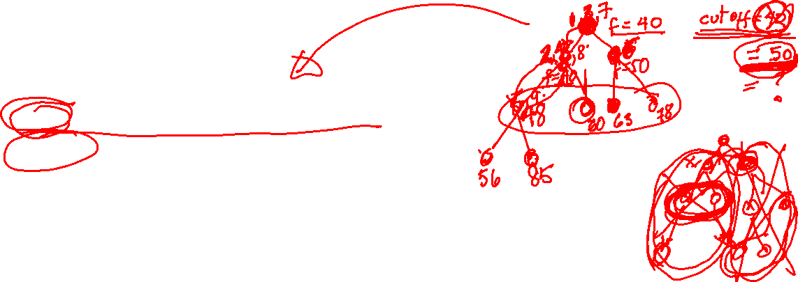
Variations of the algorithm A *
Variants of A*:
IDA*: Iterative Deepening A*
RBFS: Recursive Best-First Search
SMA*: Simplified Memory-bounded A*
They seek to reduce space complexity of A* while still being optimal.
It is achieved at the cost of increasing time complexity.

Slide 15
Iterative Deepening A* search (IDA*)
In this algorithm each iteration is a “depth-limited” search as in a normal iterative deepening search.
“Depth-limited” search is modified to use the value of the function evaluation (g + h) as cutting criteria rather than a depth restriction.
The cutting fev value for an iteration is the smallest of any node that exceeded the cutting fev value in the previous iteration.

Slide 16
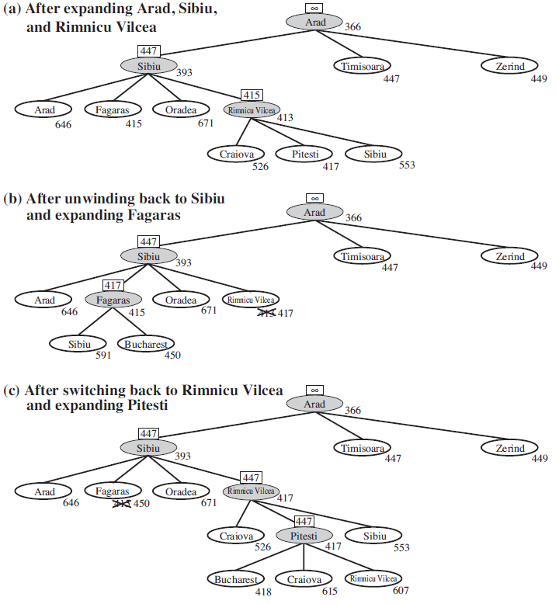
Recursive Best First Search
RBFS is a "best-first“ search, but using only linear space
RBFS is like a "depth-first" search, but instead continuing indefinitely down on a branch, it maintains the value of the FEV of the best alternative route available from any ancestor of the current node to decide if it should abandon a branch for searching in a more promising one.

Slide 17
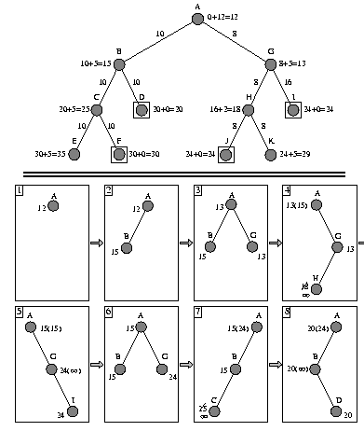
Simplified Memory-Bounded A* search (SMA*)
SMA* uses all available memory to remember the nodes where it has already searched and not have to regenerate them when necessary.
When memory is full to add new and better nodes, it eliminates the worst node, but remembers its cost by passing it to the parent of the deleted node.

Slide 18

Other uses of heuristics
To prune the search tree in other search algorithms.
Examples:
If the cost of the route to a node N is greater than some threshold, delete N from the list of candidates.
If the path to a node N contains a number of nodes greater than some threshold, delete N from the list.
Each pruning heuristic may lose the solution, but it could build a feasible solution by reducing the search space.

Slide 19
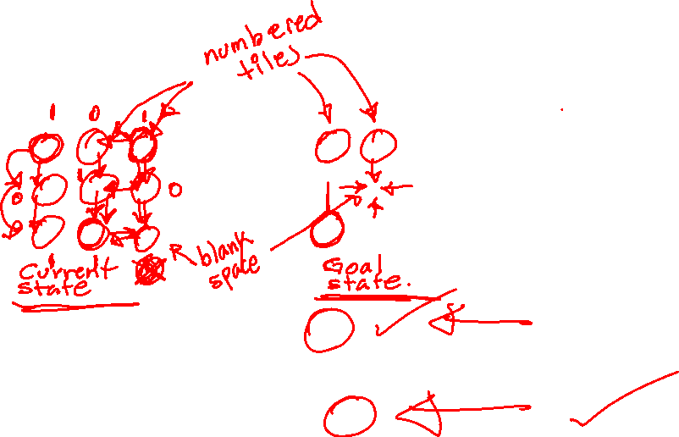
Example: heuristics for 8-puzzle
Calculate the heuristic value:
Add the boxes that are out of position with respect to the target state.
h1(n) = 1 + 0 + 1 + 0 + 1 + 0 + 1 + 1 = 5
Add the number of moves to bring each box to its position in the target state (Manhattan distance).
h2(n) = 2 + 0 + 3 + 0 + 2 + 0 + 4 + 1 = 12
7
2
6
1
2
3
8
1
4
8
4
3
5
7
6
5

Slide 20
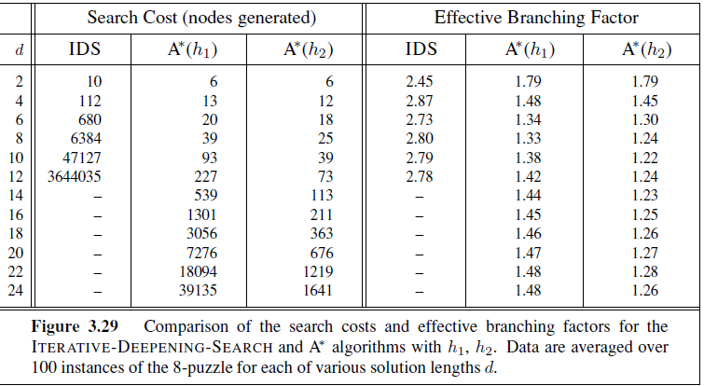
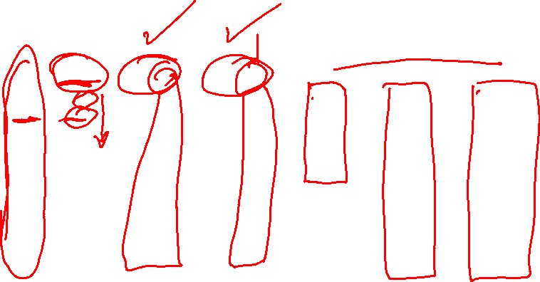
Effectiveness of heuristics
Effective branching factor (b*)
N + 1 = 1 + b + (b*)² + ... + (b*)^{d} where d is the depth of the tree.

Slide 21
Heuristic design strategy
(1) Find the optimal solution to a relaxed problem.
Example: 8-puzzle
Movement rule: A piece can move from square A to square B if A is horizontally or vertically adjacent to B and B is empty.
Relaxation possibilities:
Move a piece from A to B if A is adjacent to B.
Move a piece from A to B if B is empty.
Move a piece from A to B.
It is crucial that the relaxed problem can be essentially
solved without searching
2
8
3
1
2
3
1
6
4
8
4
7
5
7
6
5

Slide 22

Other design strategies
(2) Combine admissible heuristics.
h(n) = max{h₁(N), ..., h_{m}(N)}
(3) Use the cost of the solution to a subproblem of the original problem.
Idea behind pattern databases (Use of the exact cost of solutions to each instance of the subproblem).
(4) To learn heuristics from experience.
*
2
*
1
2
3
*
1
4
*
4
3
*
*
*
*

Slide 23
Conclusions

Slide 24
Conclusions
Since the uninformed search algorithms are systematic but inefficient, the concept of heuristics helps to solve problems in a better way.
A* search is optimal and efficient if a good heuristic is chosen.
There are variants of A* algorithm for operating with limited resources.
There are other variants of heuristic search methods.

